Slide 1

Unit – 1 Java Overview

Slide 2
B led to C, C evolved into C++, and C++ set the stage for Java.
James Gosling (Father of Java) , Patrick Naughton, Chris Warth, Ed Frank, and Mike Sheridan at Sun Microsystems.
It took 8 months to develop the first working version called “Oak”
Renamed as "Java" in 1995.
Introduction to
Java

Slide 3
Java Language Specification:
The Java language specification is a technical definition of the Java programming language’s syntax and semantics.
API: The application program interface (API) also known as library, contains predefined classes and interfaces for developing Java programs.
Java SE (Standard Edition) : for Client side programming.
Java EE (Enterprise Edition) : for Server side programming.
Java ME (Micro Edition) : for Mobile devices.
Java language Specification,
API

Slide 4
JDK:
Java Development Toolkit: The JDK consists of a set of separate programs, each invoked from a command line, for developing and testing Java programs.
JDK, IDE, JVM
IDE:
Integrated Development Environment: It is used for developing Java programs quickly where Editing, compiling, building, debugging, and online help are integrated in one graphical user interface.
Ex. NetBeans, Eclipse etc.

Slide 5
JDK, IDE, JVM
JVM:
JVM (Java Virtual Machine) is a software “engine” that runs Java programs (and other JVM languages like Kotlin/Scala).
Java code is first compiled into bytecode (.class files), not directly into machine code.
The same bytecode runs on any OS (Windows/Linux/macOS) as long as a JVM exists → “Write Once, Run Anywhere.”
JVM’s main job: load classes, verify bytecode, execute instructions, and manage memory.

Slide 6
Platform Independence
Java is platform independent because it doesn’t compile directly to OS-specific machine code.
Java source code (.java) is compiled by javac into bytecode (.class).
Bytecode is the same for all platforms (Windows/Linux/macOS).
Each platform has its own JVM, and the JVM converts bytecode into native machine code for that OS/CPU.
So the same program can run anywhere with a JVM installed → “Write Once, Run Anywhere (WORA)”.

Slide 7
As soon as a java program is compiled, java bytecode is generated in the form of a .class file
Java bytecode is the instruction set for the Java Virtual Machine.
Bytecode
Highly optimized set of instructions designed to be executed by
the Java run-time system, which is called the Java Virtual Machine(JVM)

Slide 8
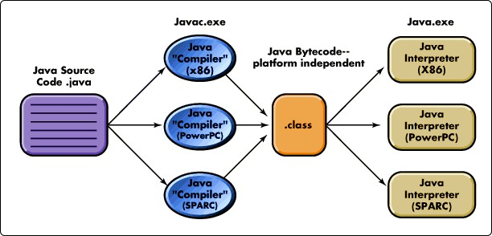
Bytecode

Slide 9
A First Simple Program Example java
import java.util.*;
class Example
{
public static void main(String args[])
{
System.out.println(“First Java program");
}
}

Slide 10
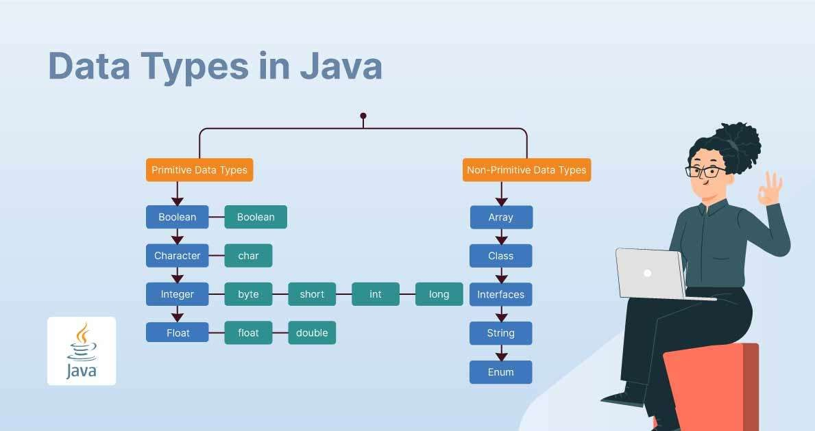
Java Data Types

Slide 11
Datatypes
1) Primitive Data Types :
These store actual values directly and have fixed sizes.
byte: 1 byte, range -128 to 127 (useful for saving memory)
short: 2 bytes, range -32,768 to 32,767
int: 4 bytes, range -2,147,483,648 to 2,147,483,647 (most common for integers)
long: 8 bytes, for very large integers (use L at end like 10000000000L)
float: 4 bytes, decimal values (use f like 3.14f)
double: 8 bytes, more precision than float (default for decimals)
char: 2 bytes, stores a single character (Unicode) like 'A', '₹'
boolean: stores true/false (size depends on JVM implementation)

Slide 12
Datatypes
2) Non-Primitive (Reference) Data Types
These store the address/reference of objects in memory.
String: e.g., "Hello"
Arrays: e.g., int[] a = {1,2,3};
Classes / Objects: e.g., Student s = new Student();
Interfaces: e.g., Runnable r;
Quick difference:
Primitive → direct value, fixed size, faster
Reference → points to an object, can have methods, generally more flexible

Slide 13
Java Literals are syntactic representations of boolean, character, numeric, or string data.
Literals provide a means of expressing specific values in your program.
Types of literals are:
Literals
Integer Literals
Floating-Point Literals
Boolean Literals
Character Literals

Slide 14
Integers
Datatype | Size | Description
byte | 1 byte | Stores whole numbers from -128 to 127
short | 2 bytes | Stores whole numbers from -32,768 to 32,767
int | 4 bytes | Stores whole numbers from - 2,147,483,648 to 2,147,483,647
long | 8 bytes | Stores whole numbers from - 9,223,372,036,854,775,808 to 9,223,372,036,854,775,807

Slide 15
Floating-Point Types
Data type | Size | Description
float | 4 bytes | Stores fractional numbers. Sufficient for storing 6 to 7 decimal digits
double | 8 bytes | Stores fractional numbers. Sufficient for storing 15 decimal digits

Slide 16
Operators
1) Arithmetic Operators:
Used for mathematical calculations.
+ (add), - (subtract), * (multiply), / (divide), % (modulus/remainder)
Example: c = a + b;
2) Unary Operators:
Work on a single operand.
+ (unary plus), - (unary minus)
++ (increment), -- (decrement)
! (logical NOT)
Example: a++; // increases a by 1

Slide 17
Operators
3) Relational (Comparison) Operators:
Used to compare two values, result is true/false.
==, !=, >, <, >=, <=
Example: a > b
4) Logical Operators:
Used with boolean conditions.
&& (AND), || (OR), ! (NOT)
Example: (a > 5 && b < 10)

Slide 18
Operators
5) Assignment Operators:
Used to assign/update values.
= , +=, -=, *=, /=, %=
Example: a += 5; // a = a + 5
6) Bitwise Operators:
Operate on bits (binary form).
&, |, ^ (XOR), ~ (NOT)
Example: a & b
7) Shift Operators:
Shift bits left/right.
<< (left shift), >> (right shift), >>> (unsigned right shift)
Example: a << 2

Slide 19
Operators
8) Ternary Operator:
Short form of if-else.
condition ? value1 : value2
Example: max = (a > b) ? a : b;
9) instanceof Operator:
Checks object type.
obj instanceof ClassName
Example: s instanceof String

Slide 20
Operators are used to perform operations on variables and values.
Java divides the operators into the following groups:
Arithmetic operators
Assignment operators
Comparison operators
Logical operators
Bitwise operators
Operators

Slide 21
Arithmetic Operators
Operator | Name | Description | Example
+ | Addition | Adds together two values | x + y
- | Subtraction | Subtracts one value from another | x - y
* | Multiplication | Multiplies two values | x * y
/ | Division | Divides one value by another | x / y
% | Modulus | Returns the division remainder | x % y
++ | Increment | Increases the value of a variable by 1 | ++x
-- | Decrement | Decreases the value of a variable by 1 | --x

Slide 22
Assignment Operators
Operator | Example | Same As
= | x = 5 | x = 5
+= | x += 3 | x = x + 3
-= | x -= 3 | x = x - 3
*= | x *= 3 | x = x * 3
/= | x /= 3 | x = x / 3
%= | x %= 3 | x = x % 3
&= | x &= 3 | x = x & 3
|= | x |= 3 | x = x | 3
^= | x ^= 3 | x = x ^ 3
>>= | x >>= 3 | x = x >> 3
<<= | x <<= 3 | x = x << 3

Slide 23
Comparison Operators
Operator | Name | Example
== | Equal to | x == y
!= | Not equal | x != y
> | Greater than | x > y
< | Less than | x < y
>= | Greater than or equal to | x >= y
<= | Less than or equal to | x <= y

Slide 24
Logical Operators
Operator | Name | Description | Example
&& | Logical and | Returns true if both statements are true | x < 5 && x < 10
|| | Logical or | Returns true if one of the statements is true | x < 5 || x < 4
! | Logical not | Reverse the result, returns false if the result is true | !(x < 5 && x < 10)

Slide 25
Bitwise Operators
Operator | Description | Example | Same as | Result | Decimal
& | AND - Sets each bit to 1 if both bits are 1 | 5 & 1 | 0101 & 0001 | 0001 | 1
| | OR - Sets each bit to 1 if any of the two bits is 1 | 5 | 1 | 0101 | 0001 | 0101 | 5
~ | NOT - Inverts all the bits | ~ 5 | ~0101 | 1010 | 10
^ | XOR - Sets each bit to 1 if only one of the two bits is 1 | 5 ^ 1 | 0101 ^ 0001 | 0100 | 4

Slide 26
Bitwise Operators
Operator | Description | Example | Same as | Result | Decimal
<< | Zero-fill left shift - Shift left by pushing zeroes in from the right and letting the leftmost bits fall off | 9 << 1 | 1001 << 1 | 0010 | 2
>> | Signed right shift - Shift right by pushing copies of the leftmost bit in from the left and letting the rightmost bits fall off | 9 >> 1 | 1001 >> 1 | 1100 | 12
>>> | Zero-fill right shift - Shift right by pushing zeroes in from the left and letting the rightmost bits fall off | 9 >>> 1 | 1001 >>> 1 | 0100 | 4

Slide 27
expression1 ? expression2 : expression3
ternary (three-way) operator
Example:
The ? Operator
String result = (marks > 40) ? "pass" : "fail";

Slide 28
Operator Precedence
Operators | Precedence
postfix | expr++ expr--
unary | ++expr --expr +expr -expr ~ !
multiplicative | * / %
additive | + -
shift | << >> >>>
relational | < > <= >= instanceof
equality | == !=
bitwise AND | &
bitwise exclusive OR | ^
bitwise inclusive OR | |
logical AND | &&
logical OR | ||
ternary | ? :
assignment | = +, = -, = *, = /, = %, = &, = ^, = |, = <<, = >>, = >>>

Slide 29
The Java if statement tests the condition. It executes the if block if condition is true.
Syntax:
if Statement
if(condition)
{
//code to be executed
}

Slide 30
class IfStatement
{
public static void main(String[] args) {
int number = 10;
// checks if number is greater than 0
if (number > 0) {
System.out.println("The number is positive.");
}
System.out.println("Statement outside if
block");
}
}
if Statement Example

Slide 31
The Java if-else statement also test the condition. It executes the if
block if condition is true otherwise else block is executed.
Syntax:
if(condition)
{
//code to be executed
}
else
{
//code to be executed when condition fails
}
If-else Statement

Slide 32
class Main {
public static void main(String[] args) { int number = 10;
// checks if number is greater than 0
if (number > 0) {
System.out.println("The number is positive.");
}
// execute this block if number is not greater than else {
System.out.println("The number is not positive.");
}
System.out.println("Statement outside if...else block");
}
}
If-else Statement Example

Slide 33
The if-else-if ladder statement executes one condition from multiple statements.
Syntax:
if(condition1){
//code to be executed if condition1 is true
}else if(condition2){
//code to be executed if condition2 is true
}
else if(condition3){
//code to be executed if condition3 is true
}
...
else{
//code to be executed if all the conditions are false
}
The if-else-if Ladder

Slide 34
class Main {
public static void main(String[] args) {
int number = 0;
if (number > 0) {
System.out.println("The number is positive.");
}
else if (number < 0) {
System.out.println("The number is negative.");
}
else {
System.out.println("The number is 0.");
}
}
}
if-else-if Ladder Example

Slide 35
The Java switch statement executes one statement from multiple conditions, and its like if-else-if ladder statement.
The switch statement works with byte, short, int, long, enum types, string.
Syntax:
switch(expression){
case value1:
//code to be executed; break; //optional
case value2:
Switch case
//code to be executed; break; //optional
default:
code to be executed if all cases are not mtched.
}

Slide 36
class Main
{
public static void main(String[] args)
{
int expression = 2;
// switch statement to check size
switch (expression) {
case 1:
System.out.println("Case 1");
// matching case
case 2:
System.out.println("Case 2");
case 3:
System.out.println("Case 3"); default:
System.out.println("Default case");
}
}
}
Switch case Example

Slide 37
The Java while loop is a control flow statement that executes a part of the programs repeatedly on the basis of given boolean condition.
Syntax:
while
while(condition)
{
//code to be executed
}

Slide 38
class Main {
public static void main(String[] args) {
// declare variables
int i = 1, n = 5;
// while loop from 1 to 5
while(i <= n) {
System.out.println(i);
i++;
}
}
}
while Example

Slide 39
If the number of iteration is not fixed and you must have to execute the loop at least once, it is recommended to use the do-while loop.
Syntax:
do-while
do
{
// body of loop
} while (condition);

Slide 40
class Main
{
public static void main(String[] args)
{
int i = 1, n = 5;
do {
System.out.println(i);
i++;
} while(i <= n);
}
}
do-while Example

Slide 41
The Java for loop is a control flow statement that iterates a part of the programs multiple times.
If the number of iteration is fixed, it is recommended to use
for loop.
for loop
Syntax:
for(initialization; condition; iteration)
{
// body
}

Slide 42
class Main
{
public static void main(String[] args)
{
int n = 5;
// for loop
for (int i = 1; i <= n; ++i) {
System.out.println("Java is fun");
}
}
}
for loop Example

Slide 43
When a break statement is encounteredinside a loop, the loop is immediately terminated and the program control resumes at the next statement following the loop.
The Java break statement is used to break loop or switch
statement.
break
It can be used as a “civilized” form of goto.

Slide 44
class Test
{
public static void main(String[] args)
{
for (int i = 1; i <= 10; ++i) {
if (i == 5) {
break;
}
System.out.println(i);
}
}
}
break Example

Slide 45
The Java continue statement is used to continue the loop.
It continues the current flow of the program and skips the remaining code at the specified condition.
In case of an inner loop, it continues the inner loop only.
while and do-while:
Control transferred directly to the conditional expression
In a for loop Control goes first to the iteration portion
continue

Slide 46
class Main
{
public static void main(String[] args)
{
// for loop
for (int i = 1; i <= 10; ++i) {
// if value of i is between 4
// and 9 continue is executed
if (i == 4 || i == 9)
{
continue;
}
System.out.println(i);
}
}
}
continue Example

Slide 47
A return statement causes the program control to transfer back to the caller of a method.
Every method in Java is declared with a return type and it is mandatory for all java methods.
return
When used, the program control transferred back to the caller of the method.

